Slide 1
Credit Card Approval Project

Slide 2
Business Implication
Credit card approval systems not transparent enough
Our Goal
Make the applicant aware of the key factors for passing
Improve Risk control
Reduce false rejection/pass rate

Slide 3
Data Acquisition
Data was acquired from kaggle
Application Record
Columns: ID, CODE_GENDER, FLAG_OWN_CAR, AMT_INCOME_TOTAL ,etc.
Credit Record
Columns: ID, MONTHS_BALANCE, STATUS

Slide 4
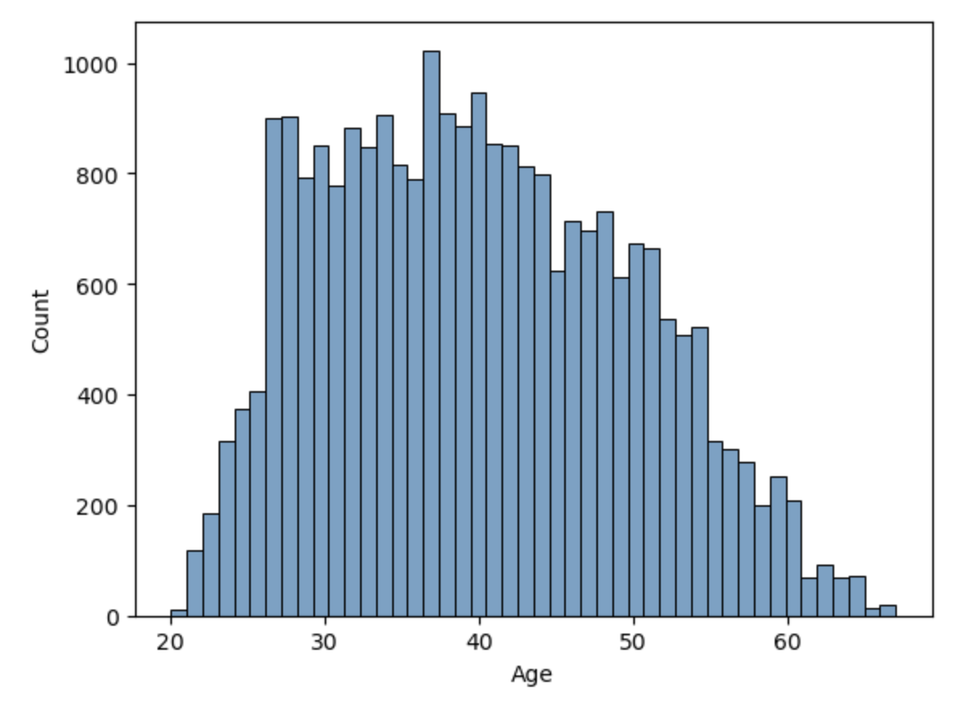
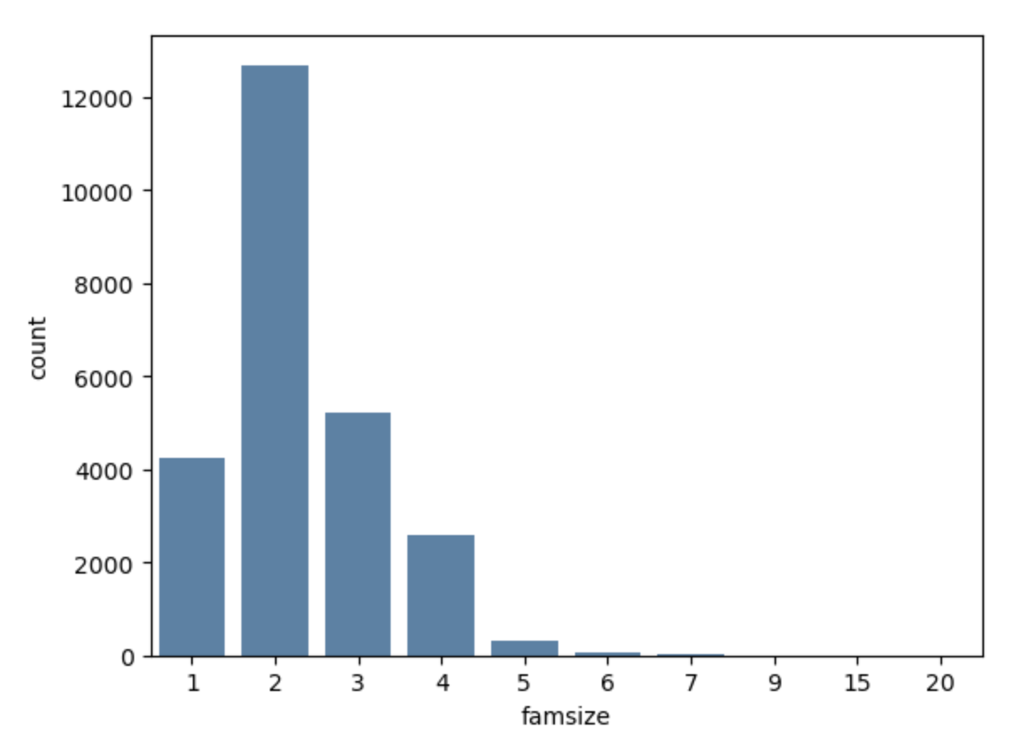
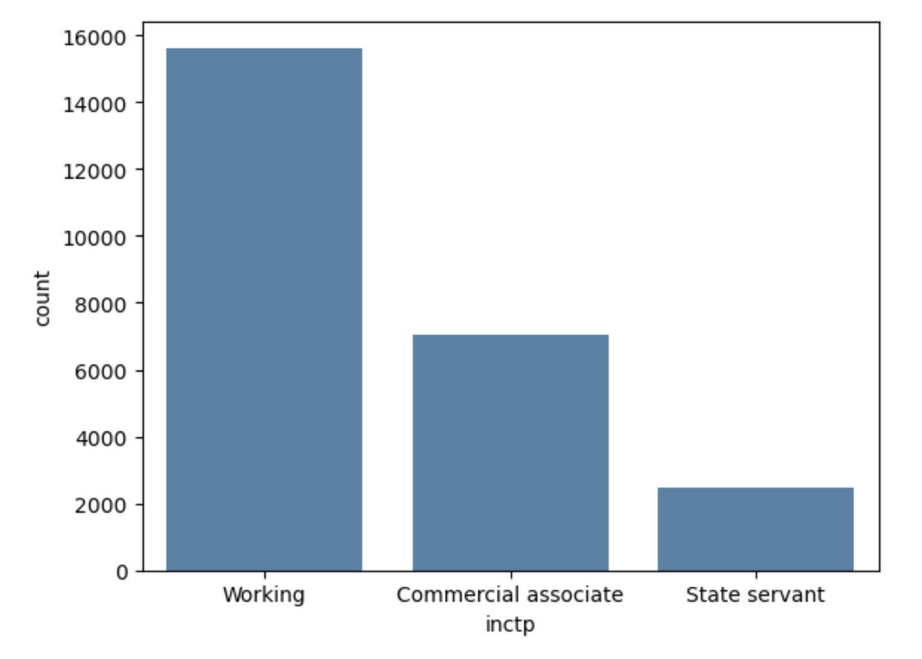
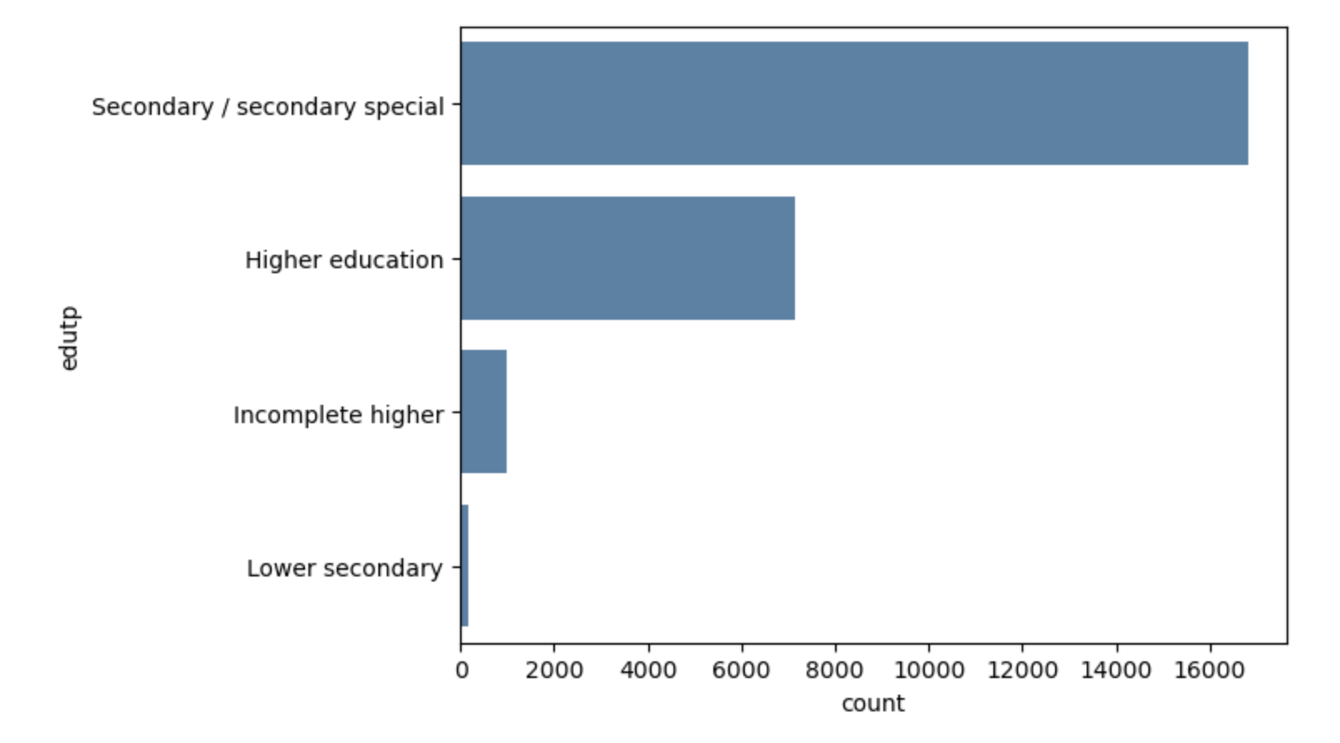
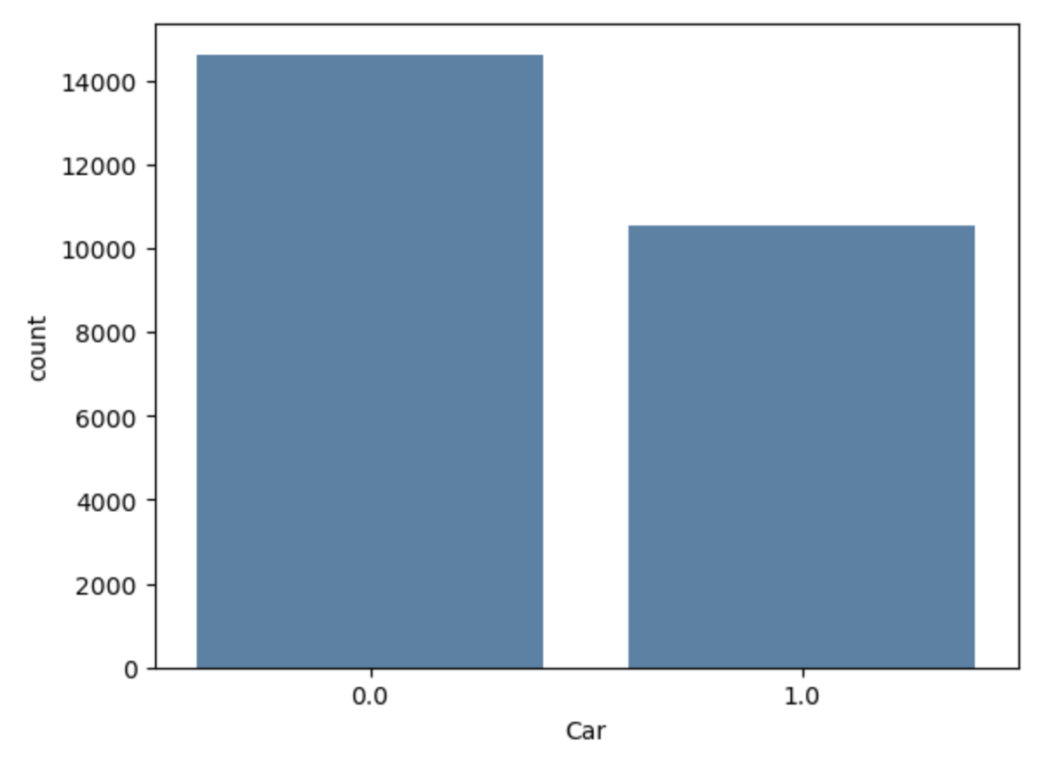
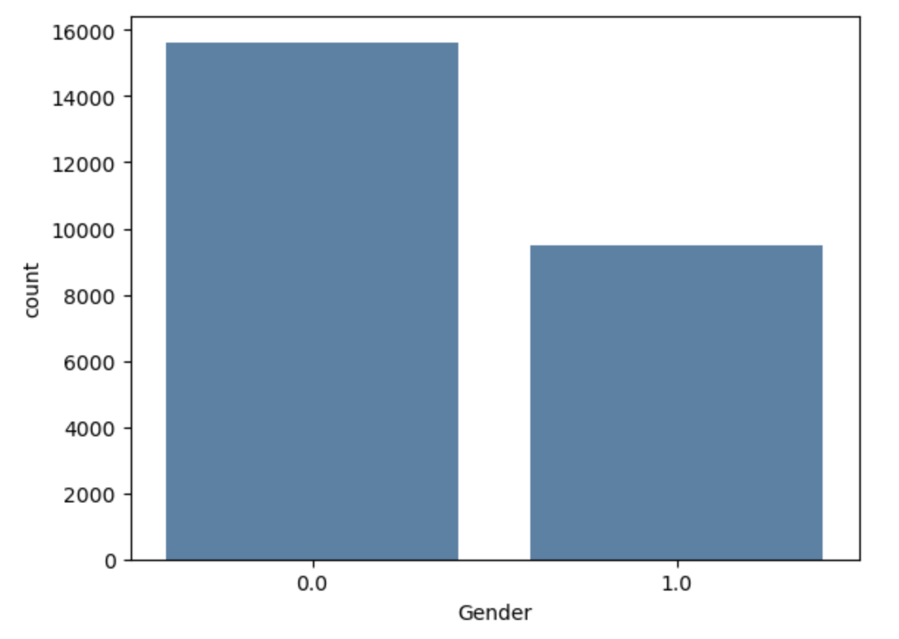
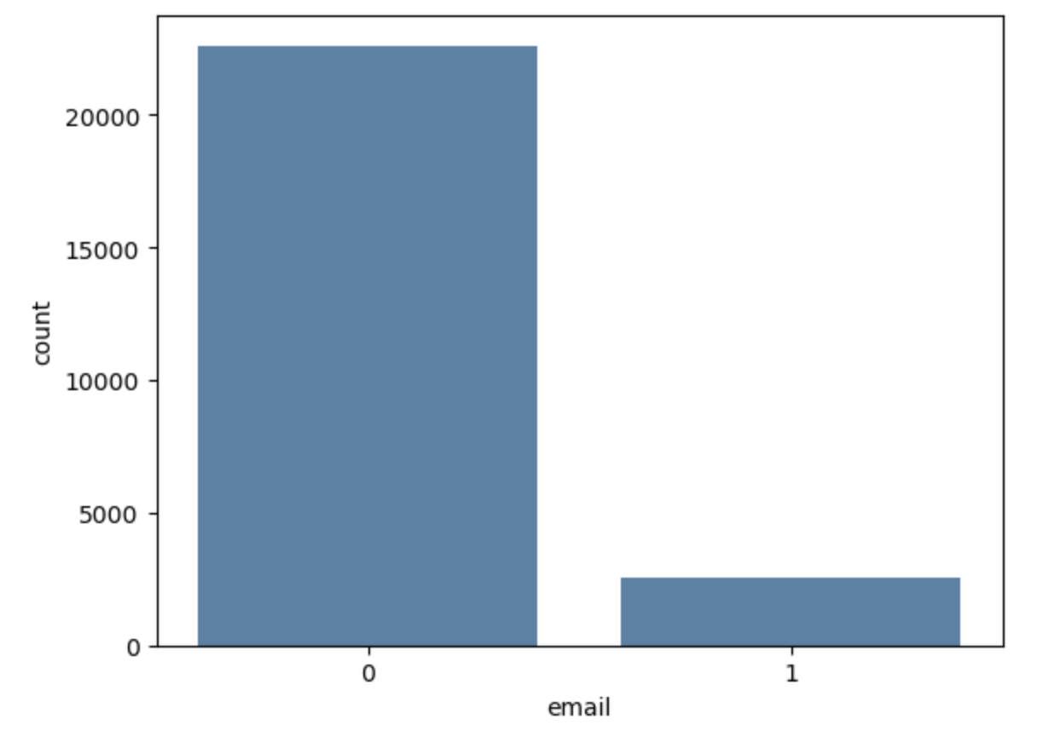
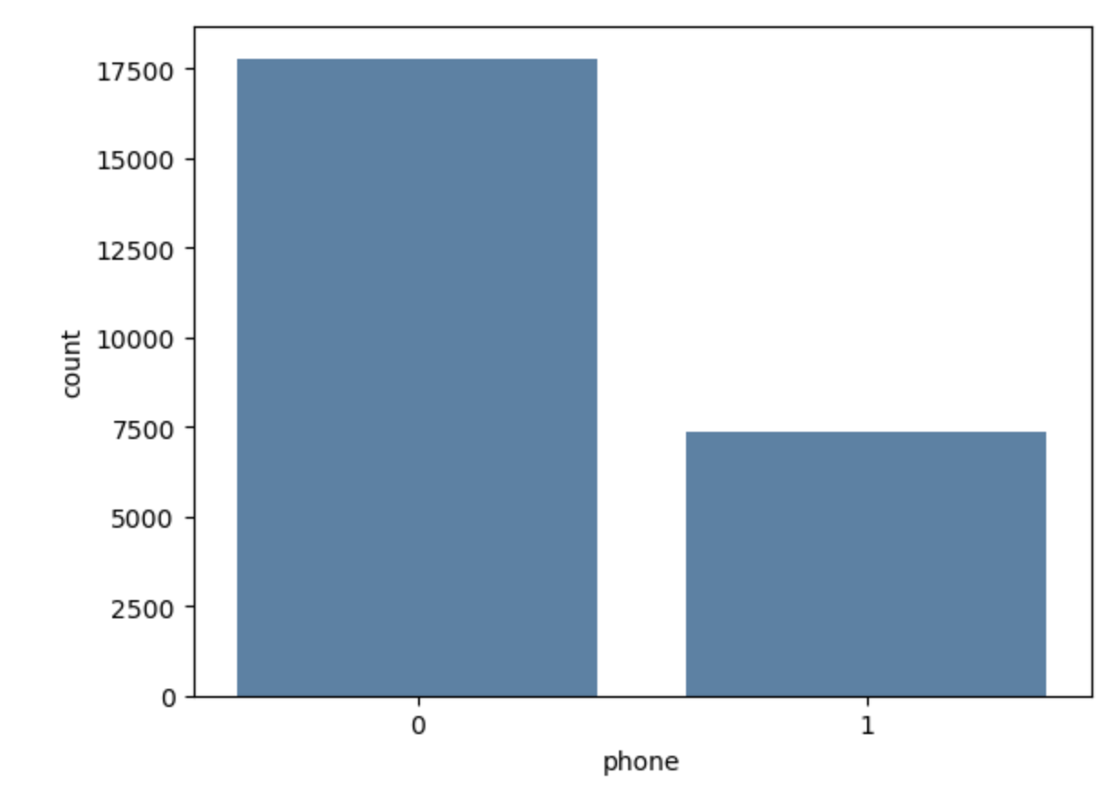
Exploratory Data Analysis
Notes:
These are just some count plots I made. Feel free to use them :D

Slide 5
Preprocessing Steps
Drop some columns which may have many null values or contains same value
Ex. OCCUPATION TYPE contains 134203 null values
Checking the Min/Max values
Ex. Min DAYS_BIRTH : -25201
Max DAYS_BIRTH : -7489
Converting data formats
Ex. From days to years
Create plots to detect outliers
Choose “STATUS” as dependent variable then merging two datasets based on ‘ID’
Converting all non-numeric Columns to numerical

Slide 6
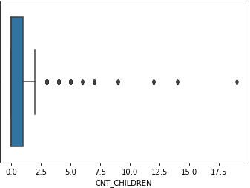
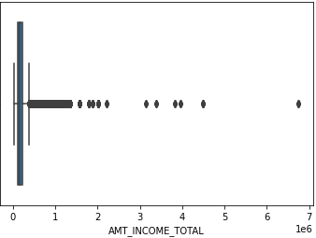
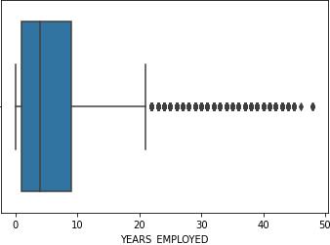
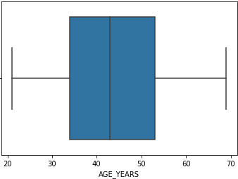
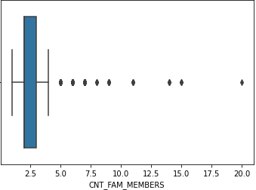
Outlier Visualization

Slide 7
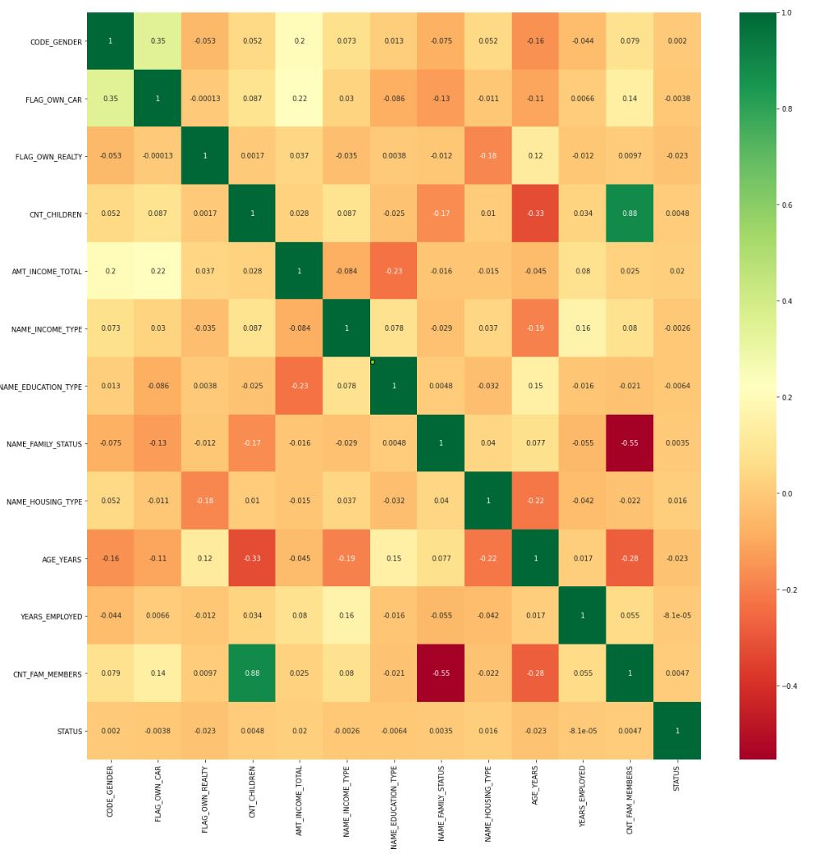
Correlation Heat Map

Slide 8
Modeling
Compared the results of 4 different classifiers
Logistic Regression
Decision Tree
Random Forest
Naive Bayes
Notes:
Since our data is categorical, we first chose to run a logistic regression mode

Slide 9
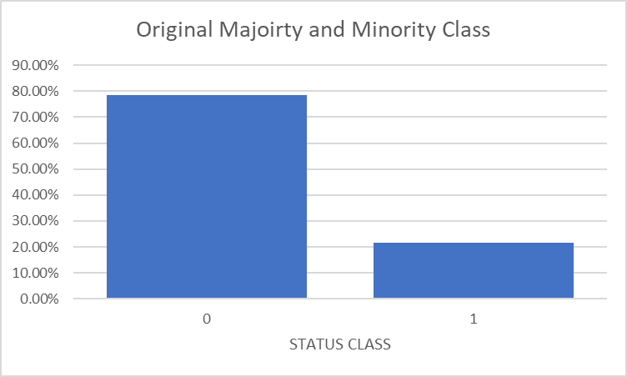
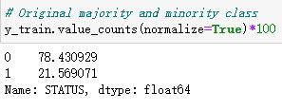
Oversampling
Oversampling involves randomly selecting examples from minority classes, with replacement, and adding them to the training dataset
Helps to adjust the class distribution of the dataset
We used SMOTE (Synthetic Minority Oversampling Technique) to resample Y_train
24712
24712
24712
Notes:
Oversampling is a process htat involves randomly selecting examples from a minority class and adding them to the training data set. This helps adjust the overall class distribution of the dataset. We used SMOTE or synthetic minority oversampling technique to resample our data.

Slide 10
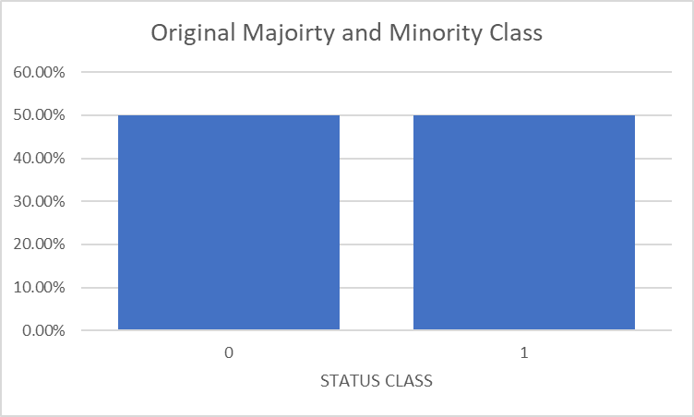
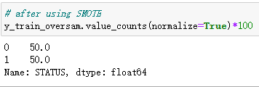
Distribution After Balancing
24712
422
Notes:
Although our initial model accuracies are extremely high, this because of the class imbalance in our data. You can see from this graph that the majority of the data belongs to the 0 class. This leads our model to create a bias that may only work on this set of data because the majority of our data belongs to the 0 class, but not with other sets of data. To prevent bias in our results or overfitting, we resampled our data

Slide 11
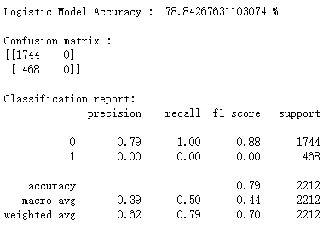
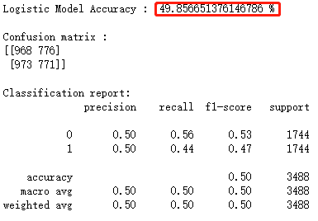
Modeling Results
Logistic Regression BB
Logistic Regression AB

Slide 12
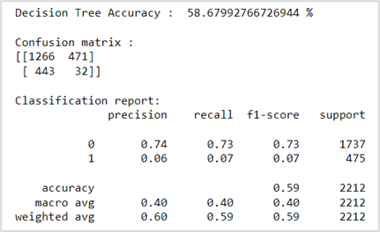
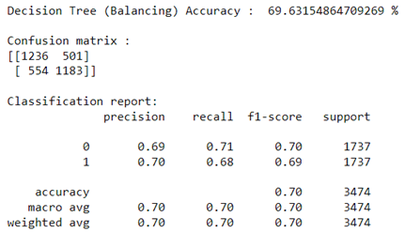
Modeling Results
Decision Tree BB
Decision Tree AB

Slide 13
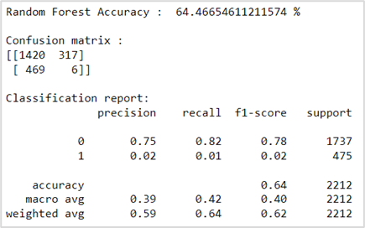
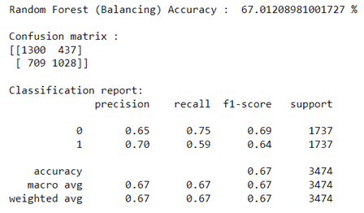
Modeling Results
Random Forest BB
Random Forest AB

Slide 14
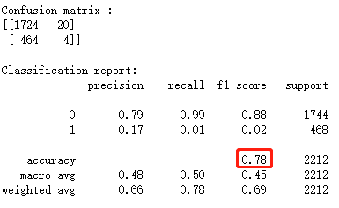
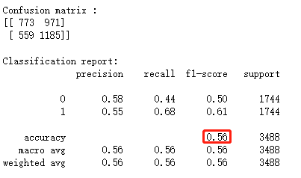
Modeling Results
Gaussian Naive Bayes BB
Gaussian Naive Bayes AB

Slide 15
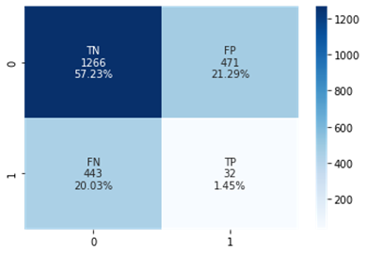
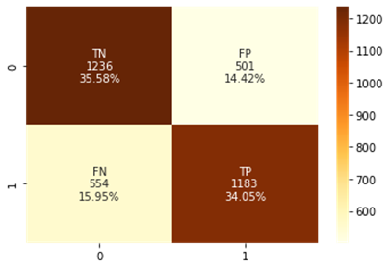
Best Model:
Decision Tree with Oversampling
Type I error rate BB: 21.29%
Type II error rate BB: 20.03%
Type I error rate AB: 14.42%
Type II error rate AB: 15.95%

Slide 16
Key Takeaways
Based on the correlation results, key factors to predict credit approval are Years of employment , Numbers of Children, Education Level, and Numbers of Family Members
Although models may seemingly perform well, you need to check for signs of overfitting
Class Imbalance
Decision Tree with Oversampling was the best model to predict credit approval

